Slide 1
Hacker Techniques, Tools, and Incident Handling
Chapter 11
Sniffers, Session Hijacking, and Denial of Service Attacks

Slide 2
Learning Objective
Perform network traffic analysis and sniffing by using appropriate tools.

Slide 3
Key Concepts
Network sniffing and traffic analysis
Session hijacking
Denial of service (DoS)
Distributed denial of service (DDoS) attacks
Botnets

Slide 4
Sniffers
An application or device designed to capture, or “sniff,” network traffic as it moves across the network
A technology used to steal or observe information
Allows viewing of email passwords, web passwords, File Transfer Protocol (FTP) credentials, email contents, and transferred files

Slide 5
Sniffers (Cont.)
Telnet
HTTP
SMTP
NNTP
POP
IMAP
FTP
Notes:
Telnet — Keystrokes can be easily sniffed if transmitted over Telnet
Hypertext Transfer Protocol (HTTP) — Designed to send information in the clear without any protection and is a good target for sniffing
Simple Mail Transfer Protocol (SMTP) — Commonly used in the transfer of email; is simple and efficient but does not include protection against sniffing
Network News Transfer Protocol (NNTP) — All communication is sent in cleartext with NNTP, including passwords and data
Post Office Protocol (POP) — Is designed to retrieve email from servers but does not include protection against sniffing because passwords and usernames can be intercepted
File Transfer Protocol (FTP) — A protocol designed to send and receive files; all transmissions are sent in the clear
Internet Message Access Protocol (IMAP) — Is similar to SMTP in function and lack of protection

Slide 6
Sniffers (Cont.)
Passive sniffing
Active sniffing

Slide 7
Passive Sniffing
Difficult to detect
Takes place and is effective when a hub is present
Can be done very simply

Slide 8
Active Sniffing
Techniques for using active sniffing and getting around limitations of switches:
Media Access Control (MAC) flooding
Address Resolution Protocol (ARP) poisoning

Slide 9
MAC Flooding
A technique for bypassing switches that overwhelms the switch with traffic designed to cause it to fail
Involves content addressable memory (CAM) and lookup tables
MAC flooding tools includes; EtherFlood, SMAC, macof, and Technetium MAC Address Changer
Notes:
Switches contain content addressable memory (CAM), which is used to build a lookup table
Lookup table tracks which MAC addresses are present on which ports on the switch
CAM allows a lookup to be performed to let the switch get traffic to the correct port and host
Lookup table is built by the switch during normal operation and resides in the CAM
Goal of MAC flooding is to exploit a design defect or oversight in some switches, which is that they have only a limited amount of memory

Slide 10
Address Resolution Protocol (ARP) Poisoning
A method of bypassing a switch where sniffing is performed on an IPv4 network
ARP poisoning occurs on IPv4 networks
IPv6 networks use Neighbor Discovery Protocol (NDP); which uses cryptography to generate addresses that can validate that the source of an NDP message is genuine

Slide 11
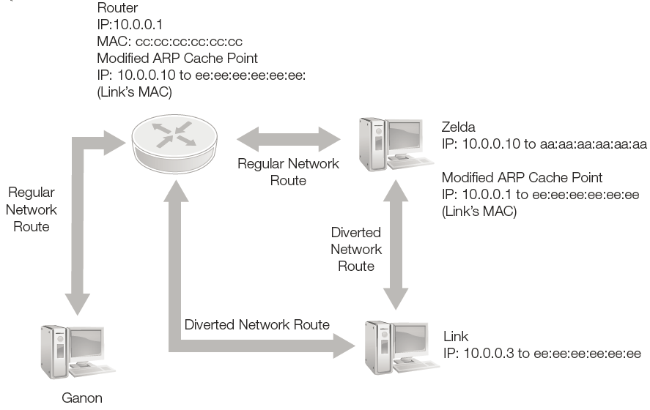
ARP Poisoning in Practice
Notes:
Attackers send out a broadcast stating that a given IPv4 address (such as a router or gateway) maps to their own MAC address.
A victim on the network initiates a communication that requires exiting the network or subnet.
When the traffic is transmitted, the ARP mapping shows that the router’s IPv4 address maps to a specific MAC address, so traffic is forwarded to the attacker instead.

Slide 12
Sniffing Tools
Wireshark
Tcpdump
Windump
Omnipeek
Dsniff
EtherApe
NetWitness NextGen
Throwing Star LAN Tap
MSN Sniffer

Slide 13
Sniffing Countermeasures
Encryption
Static ARP entries
Port security
Notes:
Encryption — Making data undecipherable protects traffic from being sniffed
Static ARP entries — Configuring devices with the MAC addresses for the devices may use it can block a number of attacks but can be difficult to manage
Port security — Switches can be programmed to allow only specific MAC addresses to send and receive data on each port

Slide 14
Session Hijacking
Occurs when attackers use a valid session to gain unauthorized access to a system, information, or service
Targets authentication, which typically takes place at the beginning of a session, making session hijacking possible after that point
Relies on a basic understanding of how messages and their packets flow over the Internet

Slide 15
Session Hijacking Process
Insert yourself between Party A and Party B.
Monitor the flow of packets using sniffing techniques.
Analyze and predict the sequence number of the packets.
Sever the connection between the two parties.
Seize control of the session.
Perform packet injection into the network.

Slide 16
Identifying an Active Session
Session hijacking builds on sniffing
Adds the goal of not only observing traffic and sessions currently active on the network but also taking over a session that has authenticated access to the resource
For a session hijack to be successful, attacker must locate and identify a suitable session for hijacking
Sounds simple but is difficult due to network segments, switches, and encryption

Slide 17
Identifying an Active Session (Cont.)
Challenges
Sequence numbers TCP packets have a unique 32-bit number embedded in header that identifies it and how it should be reassembled with other packets to regenerate original message
Network segments Difficult to carry out attack if victim and attacker are on two different network segments separated by a switch; techniques similar to active sniffing are needed

Slide 18
Identifying an Active Session (Cont.)
Sequence number facts:
Sequence numbers are 32-bit counters (integers). That means there are more than 4 billion possible sequence numbers.
Sequence numbers are used to tell the receiving machine what order the packets should go in when they are received.
An attacker must successfully determine or guess the sequence numbers to hijack a session.

Slide 19
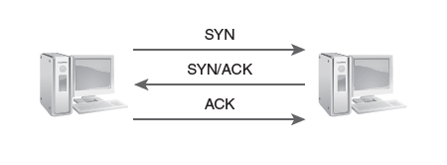
Identifying an Active Session (Cont.)
Notes:
A three-way TCP handshake — In TCP, every piece or byte of data must have a sequence number assigned to it to track the data, assemble it with its fellow packets, and perform flow control. This occurs during the three-way handshake.

Slide 20
Identifying an Active Session (Cont.)
Sequence number prediction:
When a client transmits a SYN packet to a server, the response will be a SYN/ACK. The client then responds to this SYN/ACK with an ACK. During this handshake, the starting sequence number will be assigned using a random method if the operating system supports this function.
If this sequence number is predictable, the attacker can initiate the connection to the server with a legitimate address and then open up a second connection from a forged address.

Slide 21
Session Hijacking Tools
Ethercap
A multiplatform tool that can perform man-in-the-middle attacks, ARP spoofing, and session hijacking
Hunt
A commonly used tool designed to work on Ethernet-based networks in passive and active modes
Juggernaut
A Linux network sniffer that provides the ability to hijack TCP sessions

Slide 22
Session Hijacking Tools (Cont.)
Paros HTTP Hijacker
A Java utility that is an HTTP/HTTPS proxy that allows you to intercept and edit HTTP messages in real time
IP-Watcher
A commercial-grade tool that can perform session hijacking and monitor connections
A commercial offering that can hijack TCP sessions on a network
T-sight

Slide 23
Thwarting Session Hijacking Attacks
Be proactive — use encryption
Configure routers to block spoofed traffic from outside the protected network
Use an intrusion detection system (IDS)

Slide 24
Denial of Service (DoS) Attacks
Intended to prevent services from being delivered
Are frequently aimed to consume resources, but may also involve actual disruption of a service or server
Not limited to network attacks

Slide 25
Categories of DoS Attacks
Consumption of bandwidth
Consumption of resources
Exploitation of programming defects

Slide 26
Consumption of Bandwidth
Bandwidth exhaustion
Is in effect when the network bandwidth flowing to and from a machine is consumed to the point of exhaustion
Well-known forms of attacks
Smurf
Fraggle
Chargen

Slide 27
Consumption of Resources
Synflood
ICMP flood
Smurf attack
Ping flood
Teardrop attack
Reflected attack
Notes:
SYN flood — Uses forged packets with the SYN flag set; when the victim receives enough of the packets, the result is an overwhelmed system as the SYN flood consumes connection resources to the point where no resources are available for legitimate connections
ICMP flood — Comes in two variants: Smurf attack and ping flood
Smurf attack — Carried out when a large amount of traffic is directed to the broadcast address of a network instead of to a specific system; because the attacker configures the packet with the intended victim as the source, all hosts on the network respond to the victim instead of to the attack
Ping flood — Carried out by sending a large number of ping packets to the victim with the intent of overwhelming the victim; very simple attack
Teardrop attack — Attacker manipulates IP packet fragments in such a way that when they are reassembled by the victim, a crash occurs. This process involves having fragments reassembled in illegal ways or having fragments reassembled into larger packets than the victim can process.
Reflected attack — Is carried out by spoofing or forging the source address of packets or requests and sending them to numerous systems, which in turn respond to the request; a scaled-up version of what happens in the ping flood attack

Slide 28
Exploitation of Programming Defects
Ping of Death
Teardrop
Land
Notes:
Ping of death (PoD) — Preys upon the inability of some systems to handle oversized packets; an attacker sends them out in fragments, when fragments reach the system, they are reassembled by the victim; when “magic size” of the
65,536 bytes allowed by the IP protocol is reached, some systems will crash or become victim to a buffer overflow
Teardrop — Packets are sent in a malformed state with their offset values adjusted so they overlap, which is illegal; when a system that does not know how to deal with this issue is targeted, a crash or lock may result
Land — A packet is sent to a victim’s system with the same source and destination address and port; systems that do not know how to process this will crash or lock up

Slide 29
Tools for DoS Attacks
Jolt2
Software designed to flood an older system with incorrectly formatted packets
LOIC (Low Orbit Ion Cannon)
Easy to use tool to launch DoS attacks via UDP, TCP, or HTTP
HULK (HTTP Unbearable Load King)
Allows attack to launch DoS attacks that are hard to trace
Rudy (r-u-Dead-Yet)
Easy to use HTTP DoS tool that uses the HTTP Post method

Slide 30
Distributed Denial of Service (DDoS) Attack
Uses hundreds or thousands of systems to conduct attack
Has primary and secondary victims
Attack can be difficult or impossible to track back to source
Defense is difficult, and impact is higher than DoS attack, due to number of attackers

Slide 31
Tools for DDoS Attacks
TFN
LOIC
HOIC
Slowloris
RUDY
DDOSIM-Layer 7
DAVOSET
Notes:
Tribe Flood Network (TFN) — Can launch ICMP, Smurf, UDP, and SYN flood attacks
Low Orbit Ion Cannon (LOIC) — Is able to launch DoS attacks and coordinate large numbers of bots in launching DDoS attacks
High Orbit Ion Cannon (HOIC) — Was developed to replace LOIC; focuses on DDoS attacks and requires a minimum of 50 bots to launch a scalable attack
Slowloris — Moves slowly and has the advantage that it allows the attacker to initiate attacks that consume limited resources but still cause large amounts of damage
R-U-Dead-Yet (RUDY) — Offers attackers a choice of DoS or DDoS attacks, plus can launch high-impact HTTP DDoS attacks
DDOSIM-Layer 7 DDOS Simulator — A popular attack tool that can simulate multiple attack sources (bots)
DAVOSET — Uses functionality abuse and XML External Entities (XXE) vulnerabilities to attack a designated victim

Slide 32
Botnets and the Internet of Things (IoT)
Botnets
Consist of computers and devices that are infected with software such as those used in DDoS attacks
Can stretch across globe
Internet of Things (IoT)
Devices, appliances, vehicles, and other objects that have network communication hardware and software that allow them to connect to networks
Notes:
Botnets attacks include:
DDoS attacks — This construct makes sense as an attack method based on the way a DDoS works and the number of systems that can be infected.
Sending — Botnets have been used to transmit spam and other bogus information on behalf of their owner.
Stealing information — Attacks have also been carried out with botnets to steal information from unsuspecting users’ systems.
Click fraud — This attack is where the attackers infect a large number of systems with the idea that they will use the infected systems to click on ads on their behalf, generating revenue for themselves.

Slide 33
Botnets and the Internet of Things (IoT) (Cont.)
Botnets can:
Perform DDoS attacks
Send spam
Steal information
Perform clickfraud
Notes:
Botnets attacks include:
DDoS attacks — This construct makes sense as an attack method based on the way a DDoS works and the number of systems that can be infected.
Sending — Botnets have been used to transmit spam and other bogus information on behalf of their owner.
Stealing information — Attacks have also been carried out with botnets to steal information from unsuspecting users’ systems.
Click fraud — This attack is where the attackers infect a large number of systems with the idea that they will use the infected systems to click on ads on their behalf, generating revenue for themselves.

Slide 34
Summary
Network sniffing and traffic analysis
Session hijacking
Denial of service (DoS)
Distributed denial of service (DDoS) attacks
Botnets

